Slide 1
Computer Networks
Chapter 1.3
ALOK KUMAR – ASSISTANT PROFESSOR & KARGIL TECHINCAL TRAINER (DCPD)
EMAIL: DCPD.KARGILT1@CUMAIL.IN

Slide 2
Contents
Data link layer: Functions of data link layer & services provided to network layer.
Error detection & correction: Hamming code, CRC, Parity, Checksum
Switch working
Multiple access protocols with random access protocols like: ALOHA, CSMA, CSMA/CD and CSMA/CA.

Slide 3
Data Link Layer – NEED?
Problem | Why does it occur? | Solution by Data Link Layer
Physical Layer understands only bits | It cannot understand packets, addresses, or messages. | Converts packets into Frames before transmission.
No beginning or end of data | Receiver cannot identify where one message starts or ends. | Uses Framing to organize data into frames.
Destination cannot be identified | A switch cannot determine which device should receive the data. | Adds Source MAC and Destination MAC addresses.
Transmission errors | Noise or interference may change one or more bits during transmission. | Uses FCS (Frame Check Sequence) to detect errors.
Sender transmits too fast | The receiver may not be able to process incoming data quickly enough. | Uses Flow Control to regulate the transmission speed.
Multiple devices transmit simultaneously | Two or more devices may send data at the same time, causing collisions. | Uses Media Access Control (MAC) protocols to manage channel access.

Slide 4
Data Link Layer
The Data Link Layer (DLL) is the second layer of the OSI (Open Systems Interconnection) Model. It receives data from the Network Layer, converts it into Frames, and passes these frames to the Physical Layer for transmission.
At the receiver's side, it performs the reverse operation. It receives the frame from the Physical Layer, checks whether the frame contains any errors, removes the Data Link Layer information, and forwards the original packet to the Network Layer.
The primary goal of the Data Link Layer is to provide reliable Node-to-Node communication over a single communication link.
The Data Link Layer is responsible for reliable node-to-node delivery of data by converting packets into frames, adding physical (MAC) addresses, detecting transmission errors, controlling the flow of data, and managing access to the communication medium.

Slide 5
Data Link Layer
The Data Link Layer is the 2nd layer of the OSI Model.
Its main responsibility is to provide node-to-node delivery of data over the same local network (LAN).
Unlike the Network Layer, which uses IP Addresses to deliver packets between different networks, the Data Link Layer uses MAC Addresses to deliver data between devices connected to the same network.
It also detects transmission errors and controls access to the communication medium.
The Data Link Layer is responsible for node-to-node communication, framing, physical addressing (MAC Address), error detection, and media access control within the same local network.

Slide 6
The Data Link Layer: Functionalities
Functionality | Description
Framing | Converts Network Layer packets into frames before transmission.
Physical Addressing | Uses MAC Addresses to identify sender and receiver within the same LAN.
Error Detection | Detects transmission errors using FCS (Frame Check Sequence) or CRC.
Media Access Control | Controls how devices access the communication medium to avoid collisions.
Flow Control | Prevents a fast sender from overwhelming a slow receiver on the local link.
Node-to-Node Delivery | Delivers data between directly connected devices in the same network.
Frame Synchronization | Marks the beginning and end of each frame.

Slide 7
The Data Link Layer: Protocols
Protocol / Standard | Purpose
Ethernet (IEEE 802.3) | Wired LAN communication.
Wi-Fi (IEEE 802.11 MAC) | Wireless LAN communication.
PPP (Point-to-Point Protocol) | Direct communication between two devices based on MAC Address.
HDLC (High-Level Data Link Control) | Reliable communication over point-to-point links.
Frame Relay | WAN data link technology (legacy).
ATM (Asynchronous Transfer Mode) | High-speed switching technology (legacy).

Slide 8
The Data Link Layer: Sub-Layers
Feature | LLC (Logical Link Control) | MAC (Media Access Control)
Full Form | Logical Link Control | Media Access Control
Standard | IEEE 802.2 | IEEE 802.3 (Ethernet), IEEE 802.11 (Wi-Fi)
Position | Upper sublayer of the Data Link Layer | Lower sublayer of the Data Link Layer
Main Function | Provides communication between the Network Layer and the MAC sublayer. | Controls access to the physical transmission medium and handles frame transmission.
Primary Responsibility | Identifies the Network Layer protocol and provides logical communication. | Uses MAC addresses and controls how devices transmit data on the network.
Address Used | Does not use MAC addresses. | Uses Source MAC Address and Destination MAC Address.

Slide 9
The Data Link Layer: Sub-Layers
Feature | LLC (Logical Link Control) | MAC (Media Access Control)
Frame Handling | Passes data to the MAC sublayer. | Creates and processes Ethernet/Wi-Fi frames.
Media Access | Does not control access to the network medium. | Decides when a device can transmit data to avoid collisions.
Communication Type | Logical communication between Network Layer and MAC Layer. | Physical communication over the network medium.
Protocols/Standards | IEEE 802.2 | Ethernet (IEEE 802.3), Wi-Fi (IEEE 802.11)
Error Handling | May provide logical flow and error management depending on implementation. | Detects frame errors using FCS (CRC).
Works With | Network Layer | Physical Layer

Slide 10
Data Link Layer
Data Link Layer is the second layer of seven-layer OSI reference model of computer networking and lies just above Physical Layer. It is responsible for receiving and getting data bits usually from Physical Layer and then converting these bits into groups, known as data link frames so that it can be transmitted further. It is also responsible to handle errors that might arise due to transmission of bits.
The Physical Layer is simply responsible for moving raw electronic bits (0s and 1s) across a physical wire or wireless medium. However, the Physical Layer is completely blind and lacks any intelligence. It has no idea where a message starts, where it ends, or if environmental noise flipped a bit along the way. If a computer sends a steady stream of one million bits, the receiver has no way of grouping those bits into meaningful sentences, files, or protocols.
We need a smart software layer sitting directly above the physical wires to manage this chaos, handle transmission errors, and make the physical line appear completely error-free to the upper layers. This is why the Data Link Layer (DLL) exists. It takes a raw, fragile stream of bits and transforms it into a highly organized, reliable communication channel. Understanding its structural design issues helps engineers design the software that rules network interface cards (NICs).

Slide 11
Key Functionalities of DLL / Design Issues
1. Framing
Framing is the process of breaking a continuous stream of data into smaller units called Frames by adding a Header and Trailer to each frame.
The Design Challenge: The receiver needs a clear way to know exactly where a frame starts and where it ends so it doesn't accidentally read two separate messages as one.
How it is solved: The DLL uses three primary framing techniques:
  Character Count: The frame starts with a number indicating the total length of the frame. (If that number bit flips due to noise, the entire network drops out of sync).
  Eg: [5 Hello]
  Byte Stuffing: The DLL wraps a special Flag byte (like a specific text character) at the start and end of every frame. If the actual message payload contains that same flag character by coincidence, an Escape (ESC) byte is inserted right before it to tell the receiver to treat it as data, not the end of the frame.
  Eg: F Hello ESC F India F
  Bit Stuffing: A flag string of six consecutive ones (01111110) marks the borders. To prevent the real data from matching this flag, the transmitter scans the data stream and automatically stuffs a 0 bit after every five consecutive ones it finds. The receiver automatically strips this extra 0 out.
  Eg: 01111110 DATA 01111110

Slide 12
2. Error Detection – (i) Parity Check
What it is: The simplest hardware-level method used to detect if a single bit was corrupted during transit.
The Design Challenge: Static noise on a wire can flip a 1 to a 0 or vice-versa. The receiver must know if the data arrived broken.
How it is solved: An extra bit, called the Parity Bit, is added to the end of a data block.
  Even Parity: The sender counts the ones in the data. If the count is odd, it sets the parity bit to 1 to make the total number of ones even. If it is already even, it sets it to 0.
  Odd Parity: The sender sets the parity bit so that the total count of ones across the block is always odd.
  The receiver counts the ones upon arrival. If it is using Even Parity and counts an odd number of ones, it knows an error occurred and drops the frame.

Slide 13
3. Error Detection - (ii) Checksum
What it is: A higher-level mathematical error-detection method mostly used by software protocols to check the integrity of an entire block of data words.
The Design Challenge: Simple parity checks fail completely if an even number of bits flip at the same time. The network needs a stronger multi-bit mathematical check.
How it is solved: The sender splits the data frame into equal segments of bits (usually 8 or 16 bits each). It adds all these segments together using standard binary addition rules. It then takes the final sum, flips all the bits (zeros become ones, and ones become zeros) to create the Checksum, and appends it to the end of the frame. The receiver adds all received segments plus the checksum; if the result is all ones, the data is clean.

Slide 14
4. Error Detection – (iii) CRC (Cyclic Redundancy Check)
What it is: An extremely powerful, industry-standard algebraic error-detection method based on Binary Division.
The Design Challenge: Industrial environments experience burst errors where a long spark of electricity ruins a continuous string of 10 or 20 bits at once. Neither parity nor basic checksums can reliably catch this.
How it is solved: The sender and receiver agree on a standard mathematical formula called a Generator Polynomial (represented as a binary divisor, like 1101). The sender appends a string of zeros to the data and divides it by the divisor using XOR subtraction. The leftover remainder from this division is called the CRC Frame Check Sequence (FCS). The sender replaces the trailing zeros with this remainder and sends it. The receiver divides the whole package by the same divisor; if the remainder is exactly 0, the frame is 100% clean.

Slide 15
5. Error Correction
What it is: The advanced capability of a receiver to not only detect that a packet is broken but to mathematically pinpoint exactly which specific bit flipped and repair it on the fly without asking for a re-transmission.
The Design Challenge: On long-distance satellite links or deep-sea lines, waiting for a re-transmission takes too long. The receiver must fix errors locally.
How it is solved: The layer uses Forward Error Correction (FEC) codes, most notably Hamming Codes. By interweaving multiple redundant parity bits at specific mathematical positions inside the data word, the receiver can calculate a unique binary value that reveals the exact column and row position of the corrupted bit, allowing the receiver to flip it back to its correct state.

Slide 16
6. Flow Control
What it is: The set of rules that regulates the speed of data transmission between a fast sender and a slow receiver.
The Design Challenge: If a high-speed server blasts data frames at high speeds to an old, slow laptop, the laptop's memory buffers will instantly overflow, causing it to drop packets.
How it is solved: The DLL introduces coordination protocols like Stop-and-Wait (the sender must pause and cannot send frame 2 until the receiver sends an acknowledgment back for frame 1) or Sliding Window protocols (the sender can blast a specific batch of frames before halting to wait for a clearance update).

Slide 17
7. Addressing (Physical / MAC Addressing)
What it is: The process of adding explicit hardware identity tags to a frame before dropping it onto a shared physical wire.
The Design Challenge: When multiple computers are plugged into the same local network cable or switch, there must be a way to ensure that Computer B opens the packet while Computer C and D ignore it.
How it is solved: The DLL appends a Source MAC Address and a Destination MAC Address into the frame header. Every network interface card built into a computer reads these headers at the hardware level, if the destination MAC does not match its own unique factory-assigned hardware ID, it immediately discards the frame without wasting any main processor power.

Slide 18
Error Detection – Parity Check
If a receiver accepts corrupted data without checking it, software programs can crash, bank balances can become incorrect, or files can get permanently ruined. Therefore, the Data Link Layer must implement an error detection mechanism. Parity Check is the most fundamental, light-weight, and hardware-friendly method designed to catch these transmission errors the moment a frame lands on the receiver.
The parity check method works by appending one extra single bit, called the Parity Bit, to the end of a binary data block before it leaves the sender. The value of this bit (whether it is a 0 or a 1) is completely dependent on the total count of 1s present inside the original data block.
There are two distinct types of parity check systems used in networking:
  Even Parity System
  Odd Parity System

Slide 19
Even Parity System
The Rule: The total number of 1s in the entire transmitted block (including the data bits and the added parity bit) must always add up to an even number (0, 2, 4, 6, etc.).
Sender Action: The sender counts the 1s in the raw data message. If the count is already even, the parity bit is set to 0. If the count is odd, the parity bit is set to 1 to force the total count to become even.
Receiver Action: The receiver counts all the 1s in the arriving frame. If the count is even, the frame is assumed to be safe and is accepted. If the count turns out to be odd, the receiver knows an error occurred and throws the frame away.

Slide 20
Odd Parity System
The Rule: The total number of 1s in the entire transmitted block (including data bits and the parity bit) must always add up to an odd number (1, 3, 5, 7, etc.).
Sender Action: The sender counts the 1s in the raw data. If the count is already odd, the parity bit is set to 0. If the count is even, the parity bit is set to 1 to force the total count to become odd.
Receiver Action: The receiver counts all the 1s in the arriving frame. If the count is odd, it accepts the frame. If the count turns out to be even, it rejects the frame.
The Limitation of Parity Sum
Parity checks can only detect single-bit errors (where exactly one bit flips). If a major noise spike flips an even number of bits at the exact same time (for example, two bits flip simultaneously), the total count of 1s stays mathematically consistent with the parity rule, and the error completely evades detection.

Slide 21
Example 1
Scenario: The sender wants to transmit the data word 1011010 using an Even Parity system.
Step 1 (Sender Count): Count the number of 1s in the data string 1011010. There are exactly four 1s.
Step 2 (Determine Parity Bit): Since 4 is already an even number, the sender does not need to add an extra 1. The Even Parity bit is set to 0.
Step 3 (The Code Word): The final packet sent on the wire is 10110100 (Data + Parity Bit).
Step 4 (Receiver Validation): The frame arrives at the receiver safely as 10110100. The receiver counts the total number of 1s. The count is 4 (even). Result: Frame Accepted.

Slide 22
Even Parity with a Two-Bit Error (The System Fails)
Scenario: The same code word 10110100 is sent, but a harsh electrical burst flips both the third bit (1 becomes 0) and the fifth bit (0 becomes 1) at the same time.
Step 1 (Arrival): The receiver catches the corrupted frame: 10011100.
Step 2 (Receiver Evaluation): The receiver counts the total number of 1s in the received string. The count is exactly four 1s.
Step 3 (Validation Decision): Since 4 is an even number, the receiver thinks the frame is completely healthy, even though two data bits are completely wrong. Result: Error Not Detected (System Tricked).

Slide 23
Why it is Good (Advantages) | Where it Fails (Disadvantages)
- Incredibly simple and fast; it can be implemented with minimal electronic circuits (just basic XOR gates). | - It fails completely if an even number of bits get corrupted inside the same frame.
- Requires almost zero overhead space; it only adds a single bit of extra data to your message block. | - It cannot tell you which bit flipped; it only knows something went wrong, so it cannot perform error correction.
- Perfect for ultra-reliable environments (like internal computer memory bus routing) where multi-bit errors are rare. | - Unsuited for modern wireless or long-distance copper networks where noise typically ruins clusters of multiple bits at a time.

Slide 24
Error Detection - Checksum
The checksum mechanism splits the original data payload into equal-sized segments. It then uses ones-complement arithmetic to calculate a tracking code that is sent along with the data.
The entire process operates through a strict set of rules divided between the sender and the receiver:
A. Operations at the Sender Side
Segmentation: The sender divides the binary data block into k separate segments, where each segment is exactly m bits long (typically 8 bits or 16 bits).
Ones-Complement Addition: The sender adds all these k segments together using standard binary addition.
Handling the Carry-Over: If the addition results in a carry bit that pushes past the m-bit boundary, that extra bit cannot simply be ignored. It must be sliced off and added back to the absolute right side (the least significant bit) of the running sum. This is known as Wrap-Around Carry.
Complementing the Sum: Once all segments are added and the carry-overs are wrapped back in, the sender takes the final sum and performs a ones-complement operation on it. This means every 0 is flipped into a 1, and every 1 is flipped into a 0.
Transmission: This final flipped binary string is the Checksum. The sender appends this checksum value to the end of the original data block and transmits the whole package over the network.

Slide 25
B. Operations at the Receiver Side
Segmentation: The receiver accepts the packet and cuts it up into the exact same m-bit segment lengths, keeping the received checksum segment included at the end.
Total Addition: The receiver adds all the data segments plus the checksum segment together using the exact same ones-complement addition rules.
Wrap-Around: Any carry-over bit generated during this massive sum is wrapped around and added back to the right side.
The Ultimate Check: The receiver evaluates the final sum:
  If the final sum consists of all 1s (e.g., 11111111), it means the data matches the checksum perfectly. The data is clean, and the frame is accepted.
  If even a single 0 appears anywhere inside the final sum, it mathematically proves that the bits were altered during transit. The frame is instantly rejected.

Slide 26
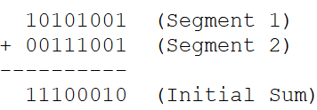
Example
Question: A sender wants to transmit the following 16-bit data stream: 1010100100111001. Using an 8-bit segment size (m = 8), calculate the checksum value at the sender side and show how the receiver validates that the incoming data is clean.
Sender Side Execution Steps:
Step 1: Segment the data. Since the block is 16 bits total and our segment size is 8 bits, we divide the data right down the middle into two blocks (Segment 1 and Segment 2).
  Segment 1 = 10101001
  Segment 2 = 00111001
Step 2: Add the segments together.
Step 3: Complement the sum to find the Checksum. Flip every bit of the final sum string 11100010.
Calculated Checksum = 00011101 - CHECKSUM
Step 4: Transmit the entire packet. The sender hooks the checksum to the back of the data segments.
Packet Sent on Wire = 10101001 00111001 00011101
(Note: This addition did not produce an extra 9th-bit carry, so no wrap-around is needed yet).

Slide 27
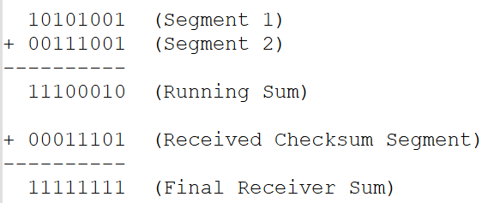
Example: Receiver Side Validation Steps
The receiver catches the complete, uncorrupted packet containing all three 8-bit segments.
Step 1: Add all received segments together (Data + Checksum).
Step 2: Check the result. Since the final sum is completely full of ones (11111111), the receiver knows no bit distortion occurred.
Result: Data Validated, Frame Accepted.

Slide 28
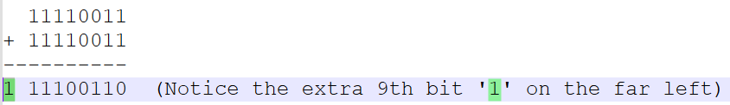
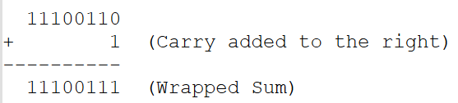
Example 2: Checksum Detection with a Carry-Over and Transmission Error
Suppose the sender wants to send two new segments: 11110011 and 11110011. Show the carry wrap-around calculation, and then show how the receiver catches an error if the first bit of the packet flips from a 1 to a 0.
Step 1: Add the segments.
Step 2: Wrap the carry around. Remove that outer left 1 and add it directly to the bottom right bit.
Step 3: Complement the wrapped sum. Flip the bits of 11100111.
Calculated Checksum = 00011000
Step 4: Sent Packet = 11110011 11110011 00011000

Slide 29
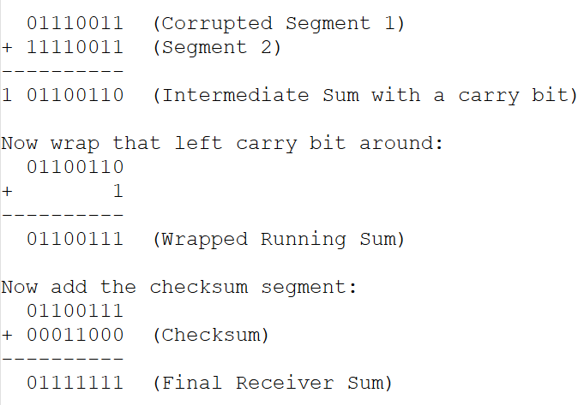
Receiver Error-Catching Execution: During the transmission, the very first bit of the first segment flips from a 1 to a 0 due to an electrical spark.
Corrupted Packet Received = 01110011 11110011 00011000
The Decision: The receiver looks closely at the final sum string: 01111111. Because the very first bit position is a 0 instead of a 1, the check fails completely.
Result: Error Successfully Detected, Frame Destroyed.

Slide 30
Why it is Good (Advantages) | Where it Fails (Disadvantages)
- Considerably stronger than a parity check; it can easily detect multi-bit and burst errors distributed across different segments. | - It can be tricked if two symmetric errors cancel each other out (for example, if a bit flips from 0 to 1 in Segment 1, and a corresponding bit flips from 1 to 0 in Segment 2, the final mathematical sum remains identical).
- Highly optimized for software implementation; it relies on simple addition operations that any basic CPU can calculate instantly without specialized network hardware. | - It creates higher packet overhead compared to parity, as it requires appending an entire 8-bit or 16-bit tracking block to your message.
- Widely trusted across the upper network protocols (like IP, TCP, and UDP layers) due to its clean software logic. | - It does not provide error correction capability; it only points out that a failure exists somewhere in the block.

Slide 31
Cyclic Redundancy Check (CRC)
The CRC method operates by treating binary bit streams as algebraic coefficients of a polynomial. For example, a binary stream of 1101 can be thought of as a polynomial equation: 1x^3 + 1x^2 + 0x^1 + 1x^0.
Rather than doing complex algebra, engineers simplify this into direct Binary Division using Modulo-2 Arithmetic. In Modulo-2 arithmetic, addition and subtraction are completely identical and are performed using a simple XOR (Exclusive OR) logical gate operation.
The process is governed by a strict set of steps shared between the sender and the receiver:
A. Operations at the Sender Side
Agreeing on a Divisor: Before communication begins, both the sender and receiver agree on a fixed bit pattern called the Generator Polynomial (or simply the Divisor). Let the number of bits in this divisor be represented as n.
Appending Zeros: The sender takes the original data block and appends exactly n - 1 zeros to its right side. This creates an extended temporary workspace block.
Modulo-2 Division: The sender divides this extended data block by the fixed divisor using Modulo-2 division (XOR subtraction).
Isolating the Remainder: The division continues until the remaining bits are shorter than the divisor. This leftover piece is the CRC Remainder (also known as the Frame Check Sequence, or FCS), and its length must be exactly n - 1 bits.
Replacing and Transmitting: The sender strips away the dummy zeros it added in step 2, replaces them with this fresh CRC remainder, and transmits the final combined frame over the network.

Slide 32
B. Operations at the Receiver Side
Receiving the Package: The receiver catches the incoming frame, which contains both the original data and the appended CRC remainder.
Direct Modulo-2 Division: The receiver takes this entire frame and divides it by the exact same agreed-upon Generator Polynomial Divisor.
Evaluating the Remainder:
  If the division finishes with a final remainder of exactly all zeros, it mathematically proves that the data payload was not altered during the journey. The frame is verified as clean and accepted.
  If even a single 1 appears anywhere in the final remainder, it means the binary code was corrupted by noise. The frame is instantly flagged and thrown away.

Slide 33
Example
Question
A sender wants to transmit the data block 100100 using the Generator Polynomial Divisor 1101. Calculate the CRC bits generated at the sender side, construct the final frame sent on the wire, and verify how the receiver detects if the transmission arrived without errors.
Sender Side Calculation Steps
Step 1: Determine the number of bits to pad. The divisor is 1101, which has a length of 4 bits (so n = 4). Therefore, we must append exactly n - 1 zeros, which is 4 - 1 = 3 zeros.
  Extended Data Block = 100100000
Step 2: Perform Modulo-2 Binary Division (XOR Subtraction). Remember the XOR rule: Same bits result in 0, different bits result in 1.
  0 XOR 0 = 0
  1 XOR 1 = 0
  1 XOR 0 = 1
  0 XOR 1 = 1
Let's trace the long division step-by-step:

Slide 34
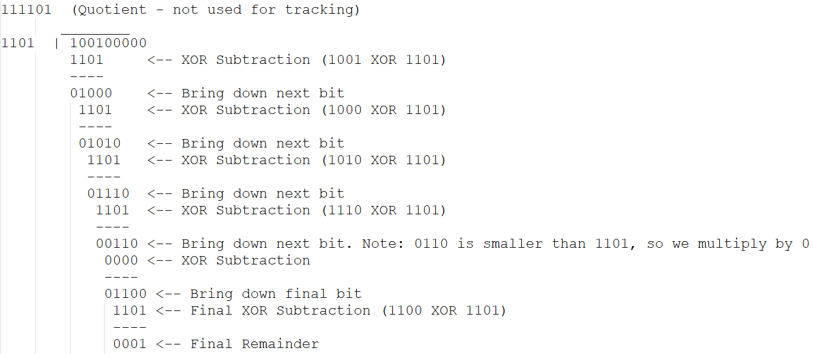

Slide 35
Step 3: Extract the CRC Remainder. The last 3 bits of our remainder give us our tracking code.
CRC Remainder (FCS) = 001
Step 4: Construct the final frame to transmit. Replace the 3 dummy zeros on the original data with our 3-bit CRC code.
Original Data = 100100
Appended CRC = 001
Final Transmitted Frame = 100100001

Slide 36
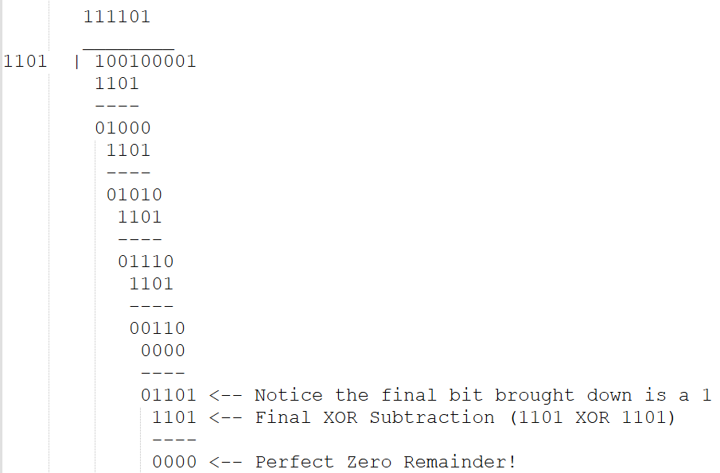
Receiver Side Verification Steps
The receiver accepts the frame 100100001 from the wire and divides it by the same divisor 1101.
The Decision: Because the final remainder is exactly 000, the receiver confirms that the data is 100% accurate.
Result: Frame Accepted.

Slide 37
Why it is Good (Advantages) | Where it Fails (Disadvantages)
- Exceptionally powerful error detection capability; it catches 100% of all single-bit errors and all burst errors shorter than the divisor length. | - Mathematically intensive compared to basic addition; it requires bit-shifting hardware components to perform division fast.
- Extremely reliable for catching long, chaotic bursts of electrical distortion that easily fool parity and checksums. | - Adds overhead to every single transmitted frame since it requires appending several extra check bits.
- Highly standardized across major hardware industries, running directly on physical computer chips for Ethernet cables and Wi-Fi cards. | - It only acts as an error detector; it cannot fix or repair the broken data bits locally, requiring a complete frame re-transmission.

Slide 38
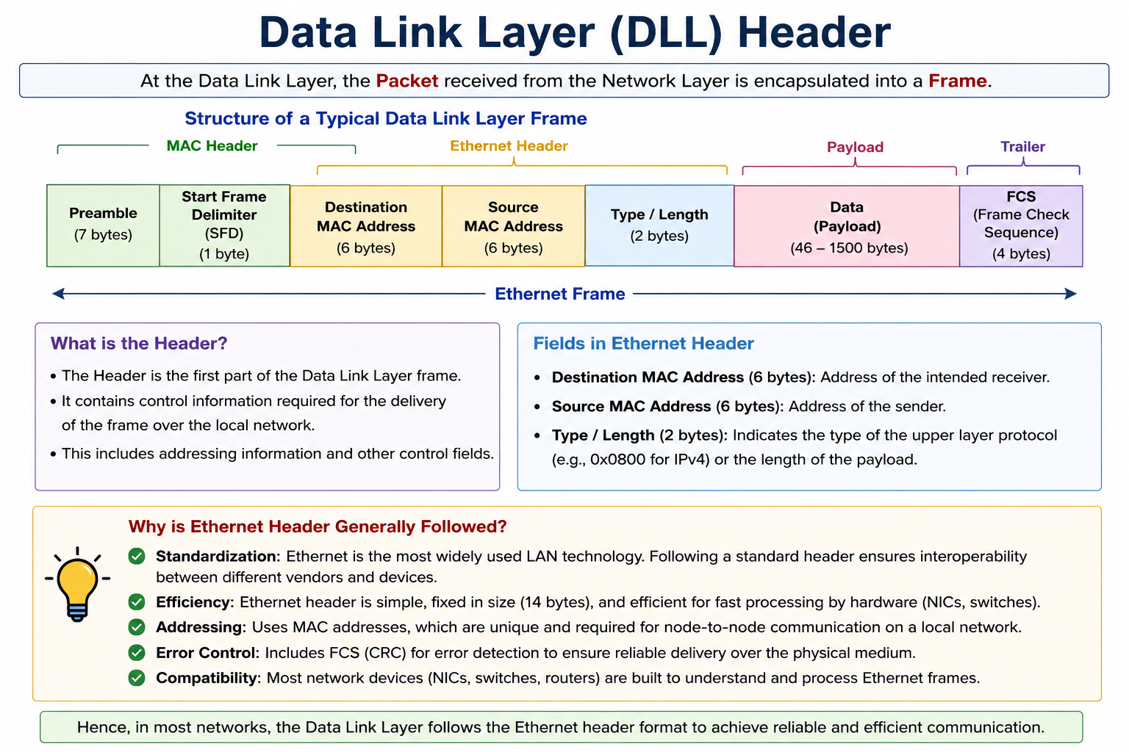

Slide 39
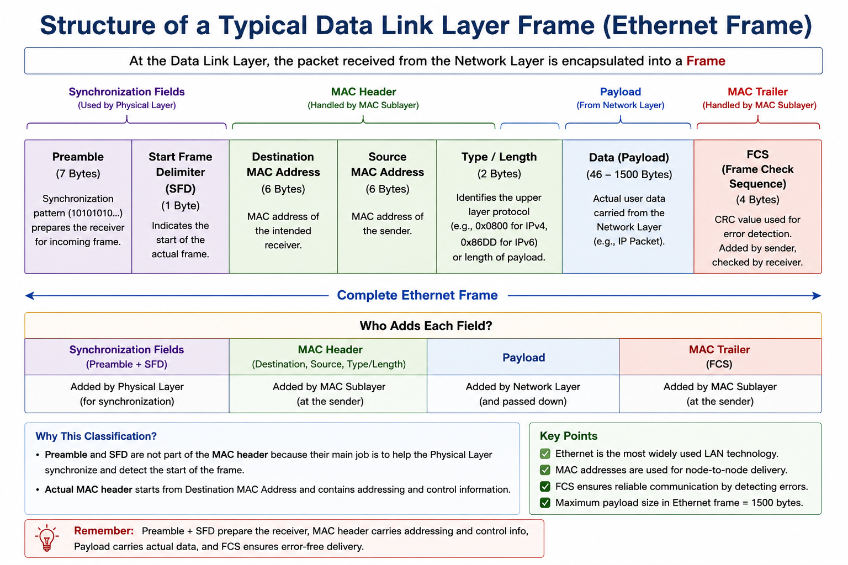

Slide 40
Field | Size | Purpose
Preamble | 7 Bytes | Synchronizes the sender's and receiver's clocks before actual data transmission begins. It prepares the receiver to receive the incoming frame.
Start Frame Delimiter (SFD) | 1 Byte | Indicates the exact beginning of the Ethernet frame. It tells the receiver that the actual frame starts immediately after this field.
Destination MAC Address | 6 Bytes | Contains the MAC address of the device that should receive the frame. Every switch reads this field to forward the frame to the correct device.
Source MAC Address | 6 Bytes | Contains the MAC address of the device that is sending the frame. It identifies the sender.
Type / Length | 2 Bytes | Identifies the protocol of the upper layer (such as IPv4, IPv6, ARP), or in older Ethernet standards, specifies the length of the payload.
Data (Payload) | 46–1500 Bytes | Contains the actual user information being transmitted. This is the data received from the Network Layer (usually an IP Packet).
FCS (Frame Check Sequence) | 4 Bytes | Used for error detection. It contains a CRC (Cyclic Redundancy Check) value calculated by the sender. The receiver recalculates the CRC and compares the values. If they differ, the frame is discarded.

Slide 41
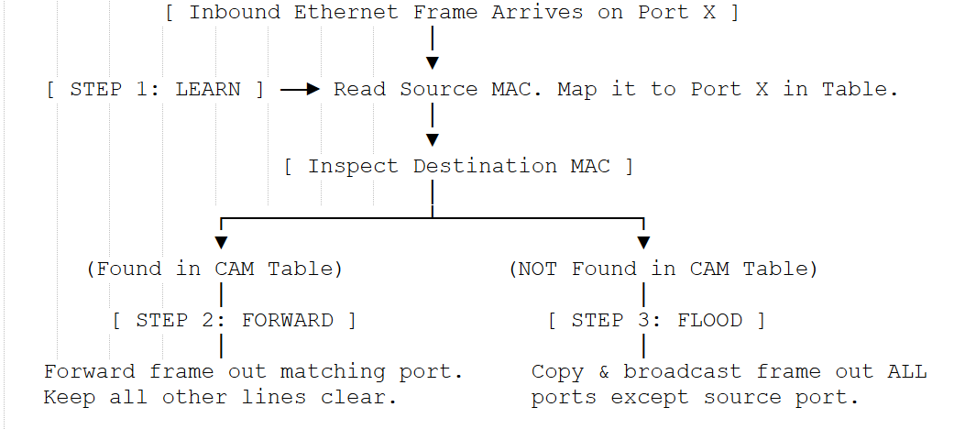
Layer 2 – Switch - Working

Slide 42
1. The Learning Phase (Source MAC Analysis)
Every time an Ethernet frame enters any port on the switch, the switch's internal controller looks inside the frame's header and reads the Source MAC Address (the identity of the sender).
It checks its CAM table. If that MAC address is not listed, the switch creates a new entry mapping that MAC address to the physical port number it just arrived on.
If the address is already in the table, it refreshes a built-in timer to ensure the map remains accurate if the device moves to a different office desk.

Slide 43
2. The Forwarding/Filtering Phase (Targeted Delivery)
Next, the switch looks at the Destination MAC Address inside the frame header (the identity of the target receiver). It runs a rapid query against its CAM table database.
If the destination MAC address is safely logged in the table, the switch executes a targeted forward. It closes an internal hardware matrix circuit to route the frame only out of the port where that destination device lives.
It completely filters (blocks) the frame from entering any other port, keeping those lines completely open for other devices to talk.

Slide 44
3. The Flooding Phase (Unknown Destination Fallback)
If the switch queries its CAM table and discovers that the destination MAC address is missing (an Unknown Unicast), it cannot perform a targeted forward.
To ensure the message gets delivered, the switch executes a fallback routine called Flooding. It duplicates the incoming frame and broadcasts it out to every single active port on the switch, except the port it originally arrived on.
When the true destination device receives the flooded frame, it transmits a reply packet back. The moment that reply hits the switch, the switch reads the sender's MAC, updates its CAM table, and never has to flood a frame for that device again.

Slide 45
Sub-Layers of Data Link Layer: LLC & MAC
When the Data Link Layer (DLL) was originally conceived, it was tasked with a massive, dual-nature responsibility: it had to interact directly with upper-layer network software protocols (like IPv4 or IPv6) while simultaneously managing raw, messy, from-scratch hardware interfaces (like copper wires, fiber optics, or radio frequencies).
This introduces a significant engineering problem:
If a software engineer writes a network driver that binds the operating system's IP packet formatting directly to a specific physical hardware medium (like a copper Ethernet cable), the entire software stack breaks the moment you try to use that same operating system over a wireless Wi-Fi link or a fiber-optic connection.
Hardware protocols change constantly, but software applications need a steady, unchanging interface to transmit data packets.

Slide 46
The Solution
To enforce clean separation of concerns, the IEEE 802 committee split the Data Link Layer into two distinct sub-layers: the Logical Link Control (LLC) sub-layer (the upper, software-facing half) and the Medium Access Control (MAC) sub-layer (the lower, hardware-facing half).
By splitting the layer in two, the upper network software remains entirely decoupled from the physical wires. The LLC acts as a universal adapter for software, while the MAC acts as a specialized driver for the physical hardware.

Slide 47
LLC and MAC
Technical Metric / Feature | Logical Link Control (LLC) Sub-layer | Medium Access Control (MAC) Sub-layer
IEEE Standard Alignment | Standardized globally under IEEE 802.2. | Governed by medium-specific standards like IEEE 802.3 (Ethernet) or IEEE 802.11 (Wi-Fi).
Layer Positioning | The upper sub-layer of the Data Link Layer; interfaces directly with the Network Layer (Layer 3). | The lower sub-layer of the Data Link Layer; interfaces directly with the Physical Layer (Layer 1).
Primary Domain / Nature | Primarily Software / Firmware driven; integrated directly into the OS network driver stack. | Primarily Hardware driven; hardcoded directly into the Network Interface Card (NIC) chipset.
Core Operational Responsibility | Protocol identification, software multiplexing, and managing logical links. | Channel allocation, hardware addressing, and resolving physical media contention.

Slide 48
LLC and MAC
Hardware Portability / Abstraction | Medium Independent: The exact same LLC software code runs whether the data moves over Wi-Fi, fiber, or copper wire. | Medium Dependent: Completely rigid; an Ethernet MAC chip cannot process or understand a wireless radio frequency channel.
Flow & Error Control Architecture | Handles high-level Software Flow Control (e.g., Sliding Window, Stop-and-Wait) and software-level packet tracking. | Handles low-level Hardware Frame Check Sequence (FCS) generation via 32-bit CRC calculation.
GATE Core Concept (Imp) | Prevents cross-contamination between different network architectures (e.g., IPv4 vs. IPv6 over the same wire). | Implements the Random Access and Multiple Access Algorithms (ALOHA, CSMA/CD, CSMA/CA).

Slide 49
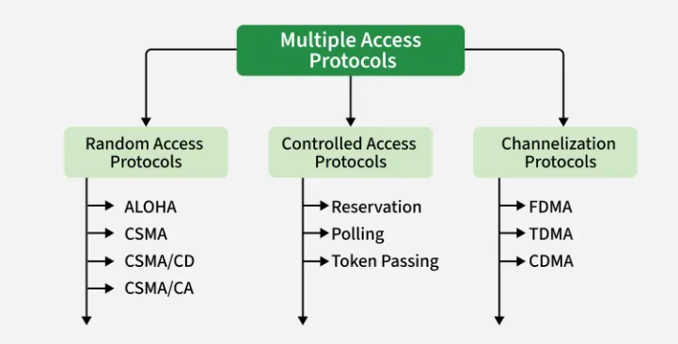
MAC Layer Need
To stop computers from interrupting each other, network engineers split all sharing rules into three main categories:

Slide 50
MAC Layer Need
Imagine a classroom where 20 people are trying to talk to each other. If everyone stays quiet and speaks one at a time, everyone can hear clearly. But if two or more people start shouting their sentences at the exact same millisecond, their voices mix together mid-air. The result is just loud, scrambled noise. No one can understand what was said, and the messages are completely lost.
In computer networks, this shared classroom is called a Broadcast Channel. It is a single physical medium like an open radio frequency in the air (Wi-Fi) or a single copper wire (Ethernet)—that many different computers share.
When two or more computers try to send data over this shared line at the same time, their electrical or radio waves physically crash into each other. In networking, this crash is called a Collision. The signals distort each other, turning the data into useless digital garbage. When the receiving computer gets this scrambled signal, it cannot read it and simply throws it away.
Without a strict set of rules to decide who gets to speak and when, a shared network would constantly suffer from collisions. Under medium or heavy traffic, the entire network would lock up, and the amount of useful data getting through would drop to zero. The rules that prevent this live inside the Medium Access Control (MAC) sub-layer of the Data Link Layer.

Slide 51
Random Access Protocols
Random Access Protocols are MAC-layer protocols where every station has an equal opportunity to access the shared communication medium.
No station receives a permanently reserved communication channel.
Whenever a station has data to send, it competes for access to the medium.
In random access method, each station has the right to the medium without being controlled by any other station,
If more then one station tries to send data, then there are high chances of collision and the frames will be either destroyed or modified.

Slide 52
To avoid access conflicts, each station follows a procedure:
When can the station access the medium?
What can the station do if the medium is busy?
How can the station determine the success or failure of the transmission?
What can the station do if there is a collision?

Slide 53
Aloha
Aloha is a random-access protocol
It was actually designed for WLAN but its also applicable for shared medium.
In this, multiple stations can transmit data at the same time and can hence lead to collisions and data being garbled.
Types
Pure Aloha
Slotted Aloha

Slide 54
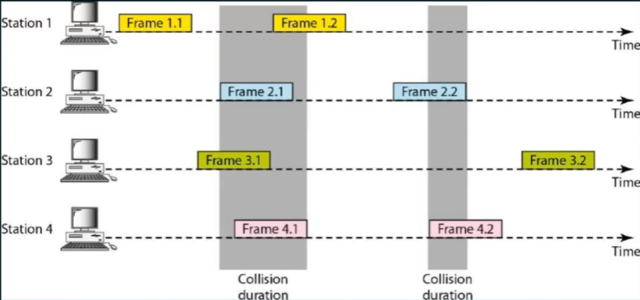
Pure Aloha
Collision
Collision
Time and Medium here is common for every station.
For understanding purpose, we have taken every station separately.

Slide 55
Pure Aloha
Pure aloha allows station to transmit whenever they have data to be sent.
When a station sends data it waits for an acknowledgment.
If the acknowledgment doesn’t come within the allotted time then the station waits or a random amount of time called back-off time(Tb) and re-sends the data.
Since different stations wait for different amount of time, the probability of further collision decreases.
The throughput of pure aloha is maximized when frames are of uniform length.
If the first bit of a new frame overlaps with just the last bit of a frame almost finished, both frames will be totally destroyed and both will have to be retransmitted later.

Slide 56
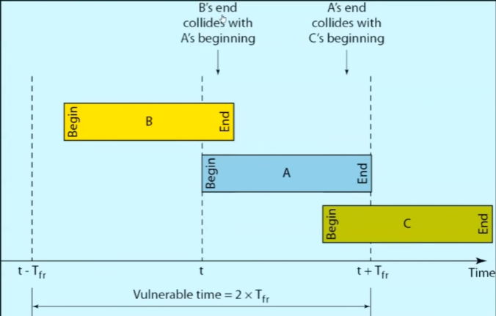
Pure Aloha
Vulnerable time = 2* T
(To transmit the frame A, we need to reserve its previous slot and the current slot, that’s why X 2)
(VT is the time period during which another transmission can collide with the current packet.)
Throughput = G*e^-2G
Where G is the number of stations wish to transmit in the same time.

Slide 57
Slotted Aloha
It was developed just to improve the efficiency of pure aloha as the chances for collision in pure aloha are high.
The time of the shared channel is divided into discrete time intervals called slots.
Sending of data is allowed only at the beginning of these slots.

Slide 58
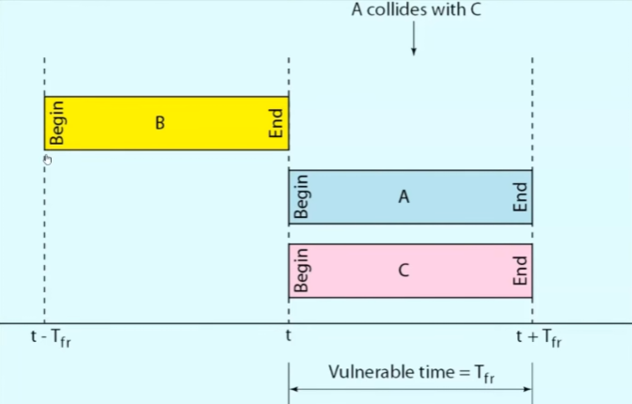
Slotted Aloha
If a station missed out the allowed time, it must wait for the next slot.
This reduces the probability of collisions.
Throughput: G x e^G

Slide 59
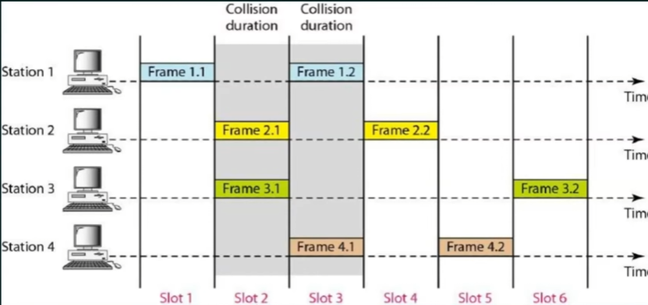
Slotted Aloha

Slide 60
Pure aloha vs Slotted Aloha
Feature / Metric | Pure ALOHA | Slotted ALOHA
Transmission Timing | Devices can send data at any time, without waiting. There is no fixed timing. | Devices can send data only at fixed time intervals or slots. They have to wait for the correct time slot to send data.
Chance of Collision | Because devices send data randomly, there is a high chance of collision (two or more devices may send data at the same time). | Since devices send data only in their own time slot, the chance of collision is much lower than Pure ALOHA.
Throughput Efficiency | Pure ALOHA has low efficiency, around 18%, because many data packets may collide and need to be sent again. | Slotted ALOHA is almost twice as efficient as Pure ALOHA. It has around 37% efficiency, because data is sent in a more organized way.
Time Synchronization | Pure ALOHA does not require any time synchronization between the devices. Each device sends data freely. | Slotted ALOHA requires all devices to be time-synchronized, so they know exactly when their slot comes to send the data.
Complexity to Implement | Pure ALOHA is simpler to implement because it doesn't require clock or timing mechanisms. | Slotted ALOHA is a bit more complex to implement because devices must follow timing rules and be synchronized.
Real-Life Analogy | Imagine many people speaking in a room whenever they want. They often talk over each other, and messages may not be heard clearly. | Imagine people taking turns to speak, like in a meeting. Each person speaks in their own time slot, so everyone can hear clearly without interruption.

Slide 61
Carrier Sense Multiple Access (CSMA)
To minimize the chance of collision and, therefore increase the performance, the CSMA method was developed.
Principle of CSMA: “Sense before Transmit” or “Listen before talk”.
When Carrier busy = Means Transmission is taking place.
When Carrier idle = Means No transmission taking place.
The possibility of collision still exists because of propagation delay: a station may sense the medium and find it idle, only because the first bit sent by another station has not yet been received.
It is used in ethernet network (Wired).
Types:
1-Persistent CSMA
P-Persistent CSMA
Non-Persistent CSMA
O-Persistent CSMA
CSMA Modified Protocols:
CSMA/CD (CSMA with Collision Detection)
CSMA/CA (CSMA with Collision Avoidance)

Slide 62
1-Persistent CSMA
Before sending the data, the station first listens to the channel to see if anyone else is transmitting the data at that moment.
If the channel is idle, the station transmits a frame.
If busy, it senses the transmission medium continuously until it becomes idle.
Since, the station transmits the frame with probability of 1 when the carrier or channel is idle, this scheme of CSMA is called as 1-Persistent CSMA.
The propagation delay has an important effect on the performance of the protocol.
The longer the propagation delay, the more important this effect becomes, and, worsens the performance of the protocol.
The number 1 means
Transmit immediately (100% probability) when the channel becomes free.

Slide 63
1-Persistent CSMA
Advantage | Explanation
Very simple | Easy to implement because devices continuously monitor the channel.
Low waiting time | As soon as the channel is free, transmission starts immediately.
Better than ALOHA | Collisions are fewer because the channel is sensed before transmitting.
Good under light traffic | Works efficiently when only a few devices share the channel.
Disadvantage | Explanation
High collision probability under heavy traffic | Multiple waiting devices transmit at the same instant when the channel becomes free.
Continuous channel sensing | Devices keep monitoring the channel, consuming resources.
Not efficient for busy networks | Performance decreases significantly as the number of devices increases.

Slide 64
Non-Persistent CSMA
Non-Persistent CSMA is a Carrier Sense Multiple Access protocol in which a station first senses the channel. If the channel is busy, it does not continuously monitor the channel. Instead, it waits for a random period of time before sensing the channel again.
The word Non-Persistent means Do not keep continuously checking the channel.
Instead,
Wait
Come back later
Check again

Slide 65
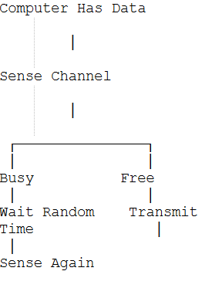
Non-Persistent CSMA – Flow Diagram

Slide 66
Non-Persistent CSMA
Advantage | Explanation
Much fewer collisions | Random waiting prevents many devices from transmitting simultaneously.
Better bandwidth utilization | Less bandwidth is wasted because fewer packets collide.
Better performance under heavy traffic | Performs better than 1-Persistent CSMA when many devices are sharing the channel.
No continuous monitoring | Devices do not waste resources by constantly sensing the channel.
Disadvantage | Explanation
Higher waiting time | A device may wait even after the channel becomes free.
Increased transmission delay | Random waiting introduces additional delay before data is sent.
Slightly more complex | Requires random backoff timing.
"Can we create a protocol that reduces collisions like Non-Persistent CSMA but also reduces the waiting time?“

Slide 67
P-Persistent CSMA (0 + 1 CSMA)
P-Persistent CSMA is a Carrier Sense Multiple Access protocol in which a station senses the channel. When the channel becomes free, it transmits with probability P and waits until the next time slot with probability (1 − P).
The word P means Probability of Transmission
P = 0.5
means
50% chance of transmitting
50% chance of waiting
Unlike 1-Persistent and Non-Persistent CSMA,
P-Persistent works in Slotted Channels.
That means
|-----|-----|-----|-----|-----|
Slot1 Slot2 Slot3 Slot4 Slot5
Transmission can begin only at the start of a slot.

Slide 68
P-Persistent CSMA (0 + 1 CSMA)
It applies to slotted channels.
When a station becomes ready to send, it senses the channel.
If it is idle, it transmits with a probability P.
With a probability Q=1-P, it defers until the next slot.
If that slot is also idle, it either transmits or defers again, with probabilities P and Q.
This process is repeated until either the frame has been transmitted or another station has begun transmitting.
In the latter case, the unlucky station acts as if there had been a collision (i.e., it waits a random time and starts again).
If the station initially senses the channel busy, it waits until the next slot and applies the above algorithm.

Slide 69
P-Persistent CSMA (0 + 1 CSMA) Eg:
Imagine A classroom has one microphone. Three students want to ask questions. Instead of rushing, the teacher says:
"When the microphone becomes free, toss a coin.“
Rule: If head -> then Speak | Tails -> then wait for next turn (with this collisions are reduced)

Slide 70
P-Persistent CSMA
Advantage | Explanation
Fewer collisions | Not all devices transmit immediately after the channel becomes free.
Better efficiency | Balances collision probability and waiting time.
Better bandwidth utilization | Less bandwidth is wasted due to fewer collisions.
Flexible | The value of P can be adjusted according to network traffic.
Disadvantage | Explanation
Requires synchronization | Works with slotted channels, so all devices must follow the same time slots.
More complex | Requires probability calculations.
Choosing the correct P value is difficult | A very high P increases collisions, while a very low P increases delay.

Slide 71
Comparison
Feature | 1-Persistent | Non-Persistent | P-Persistent
Channel Busy | Keep listening | Wait random time | Wait until free
Channel Free | Send immediately | Sense again after waiting | Send with probability P
Collision Probability | High | Low | Medium to Low
Delay | Low | High | Medium
Synchronization Required | No | No | Yes
Best For | Light traffic | Heavy traffic | Moderate traffic with slotted systems

Slide 72
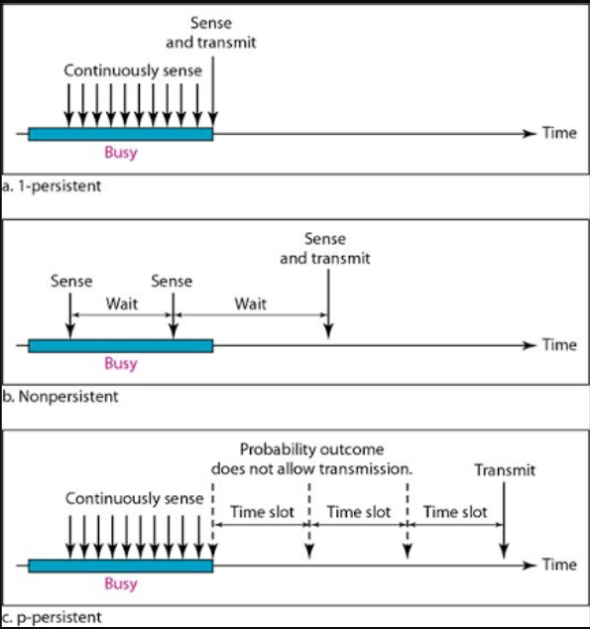

Slide 73
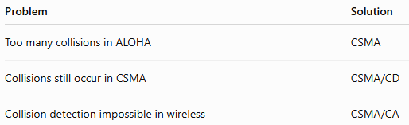
Need for CSMA/CD & CSMA/CA?
CSMA Cannot Completely Prevent Collisions
After Collision, CSMA Gives No Solution
Wired and Wireless Networks Behave Differently
Efficient Use of Bandwidth

Slide 74
Need for CSMA/CD & CSMA/CA?
All of them have one common problem:
They try to reduce collisions, but they cannot detect a collision after it occurs.
Engineers thought,
"If a collision happens while transmitting, why continue sending the entire frame? Why not stop immediately?"

Slide 75
CSMA/CD
Carrier Sense Multiple Access with Collision Detection.
Even after transmitting data -> it still listens to the carrier.
If a collision occurs, detect it immediately and stop transmitting to save bandwidth.
CSMA/CD is only used in tradition wired ethernet. Eg: Hub-based LAN etc.
Modern switched Ethernet (Full Duplex) does not use CSMA/CD because there are no collisions. [Separate carrier for sending and receiving].
In Short, CSMA/CD (Carrier Sense Multiple Access with Collision Detection) is a medium access protocol in which a device first senses the communication channel before transmitting. While transmitting, it continuously monitors the channel. If a collision is detected, the device immediately stops transmission, sends a Jam Signal, waits for a random backoff time, and then retransmits the frame.
Listen Before Sending + Listen While Sending

Slide 76
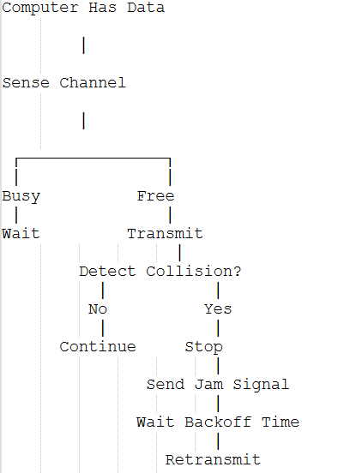
CSMA/CD
Suppose
PC-A
and
PC-B
both start transmitting.
Instead of sending
the remaining
1500 bytes,
they stop.
Bandwidth is saved.
PC A ========>
PC B <========
What is a Jam Signal?
After detecting a collision,
the sender transmits a special signal called a
Signals collide.
Immediately,
both detect
Collision!
It informs every device
on the shared network that:
Collision Has Occurred
so that
all devices discard the corrupted frame.

Slide 77
CSMA/CD
Advantage | Explanation
Detects collisions immediately | Stops transmission as soon as a collision is detected.
Saves bandwidth | Does not waste time sending an entire corrupted frame.
Better efficiency | Performs much better than ALOHA protocols.
Simple for wired shared networks | Widely used in traditional Ethernet (hub-based networks).
Disadvantage | Explanation
Works only in shared wired networks | Requires devices to hear collisions on the medium.
Cannot be used in wireless networks | Wireless devices cannot reliably detect collisions while transmitting.
Less useful with switches | Modern switched Ethernet provides each device with a dedicated link, so collisions are eliminated.

Slide 78
Where CSMA/CD is used?
Network Type | CSMA/CD Used? | Reason
Hub-Based Ethernet | Yes | All devices share the same cable, so collisions are possible.
Bus Topology | Yes | Shared communication medium.
Switched Ethernet | No | Each device has a dedicated link; collisions do not occur.
Wi-Fi | No | Wireless devices cannot detect collisions while transmitting. Wi-Fi uses CSMA/CA instead.

Slide 79
CSMA/CA
Until now, every protocol that we studied was mainly designed for wired networks.
But when wireless networks (Wi-Fi) became popular, engineers faced a new problem.
They asked, "How can we detect a collision if two laptops are transmitting wirelessly?"
The answer was
You can't detect it reliably.
So instead of Collision Detection (CD), wireless networks use CSMA/CA.
One detects collision after it happens.
The other tries to avoid collision before it happens.

Slide 80
CSMA/CA
CSMA/CA (Carrier Sense Multiple Access with Collision Avoidance) is a medium access protocol used in wireless networks in which a station first senses the communication channel before transmitting. If the channel is busy, it waits. If the channel is free, it waits for a short period, performs a random backoff, and then transmits to minimize the possibility of collisions.
In simple words, Don't wait for a collision to happen. Try to prevent it.
Over here, the career is (Wireless Medium)

Slide 81
CSMA/CA - Working
Step 1
Computer has data.
Data Ready
Step 3
When channel becomes free,
DO NOT transmit immediately.
Instead,
wait for a short time.
This short waiting time is called
IFS
(Inter Frame Space)
Step 4
Generate a random Backoff Timer.
Example
Laptop A
Backoff = 2
Laptop B
Backoff = 6
Step 2
Sense the wireless channel.
Busy?
↓
Wait
If busy,
keep waiting.
It is a small waiting period before transmission.
Purpose
To give higher-priority frames
a chance to transmit first.
Think of it as a small pause before speaking.

Slide 82
CSMA/CA - Working
Step 5
Countdown begins.
2
1
0
↓
Transmit
Only the computer whose timer reaches zero first transmits.
The others stop their countdown and wait.
Collision is avoided.

Slide 83
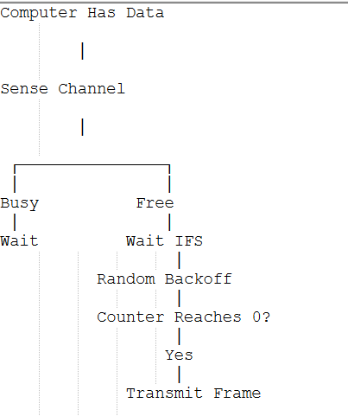
CSMA/CA

Slide 84
CSMA/CA: RTS and CTS
To reduce collisions even further,
Wi-Fi can use
two special control frames.
RTS(REQUEST TO SEND): The sender asks “Can I send my data”?
CTS(CLEAR TO SEND): The receiver replies, "Yes, the channel is reserved for you. Go ahead.“
All other devices hearing the CTS remain silent, greatly reducing collisions.

Slide 85
CSMA/CA

Slide 86
CSMA/CA

Slide 87
CSMA/CA

Slide 88
CSMA/CA

Slide 89
CSMA/CD
Advantage | Explanation
Reduces collisions | Uses IFS, random backoff, and optionally RTS/CTS to avoid simultaneous transmissions.
Suitable for wireless networks | Works well where collision detection is not practical.
Better bandwidth utilization | Fewer retransmissions mean more efficient use of the wireless channel.
Reliable communication | Improves successful frame delivery in Wi-Fi networks.
Disadvantage | Explanation
More delay | Waiting for IFS and backoff increases transmission time.
More overhead | RTS, CTS, and ACK frames consume additional bandwidth.
More complex | Requires extra coordination compared to CSMA/CD.

Slide 90
CSMA/CD VS CSMA/CA
Feature | CSMA/CD | CSMA/CA
Full Form | Carrier Sense Multiple Access with Collision Detection | Carrier Sense Multiple Access with Collision Avoidance
Used In | Wired Ethernet (Hub/Bus) | Wireless Networks (Wi-Fi)
Collision Handling | Detects collision after it occurs | Tries to avoid collision before it occurs
Collision Detection | Yes | No
IFS | No | Yes
Random Backoff | Yes (after collision) | Yes (before transmission)
RTS/CTS | No | Yes
ACK | Not mandatory for Ethernet | Used to confirm successful reception
Efficiency | High in shared wired networks | Optimized for wireless environments

Slide 91
CSMA/CA

Slide 92
CSMA/CA

Slide 93
CSMA/CA

Slide 94
CSMA/CA

Slide 95
CSMA/CA

Slide 96
CSMA/CA

Slide 97
CSMA/CA

Slide 98
CSMA/CA

